Slide 1


Transforming time-series signal to graph
Feb 2020
Università della Svizzera italiana
Amirehsan Davoodi
Supervisors: Cesare Alippi - Daniele Zambon

Slide 2
Contents
Selected time-series data (ECG/EKG)
Signal processing analysis on the data
Detect heartbeats
Build graph for each heartbeat
Visibility graph
Horizontal visibility graph
Graph Signals
Optimize the graph using Machine Learning

Slide 3

Selected time-series data (ECG/EKG)

Slide 4
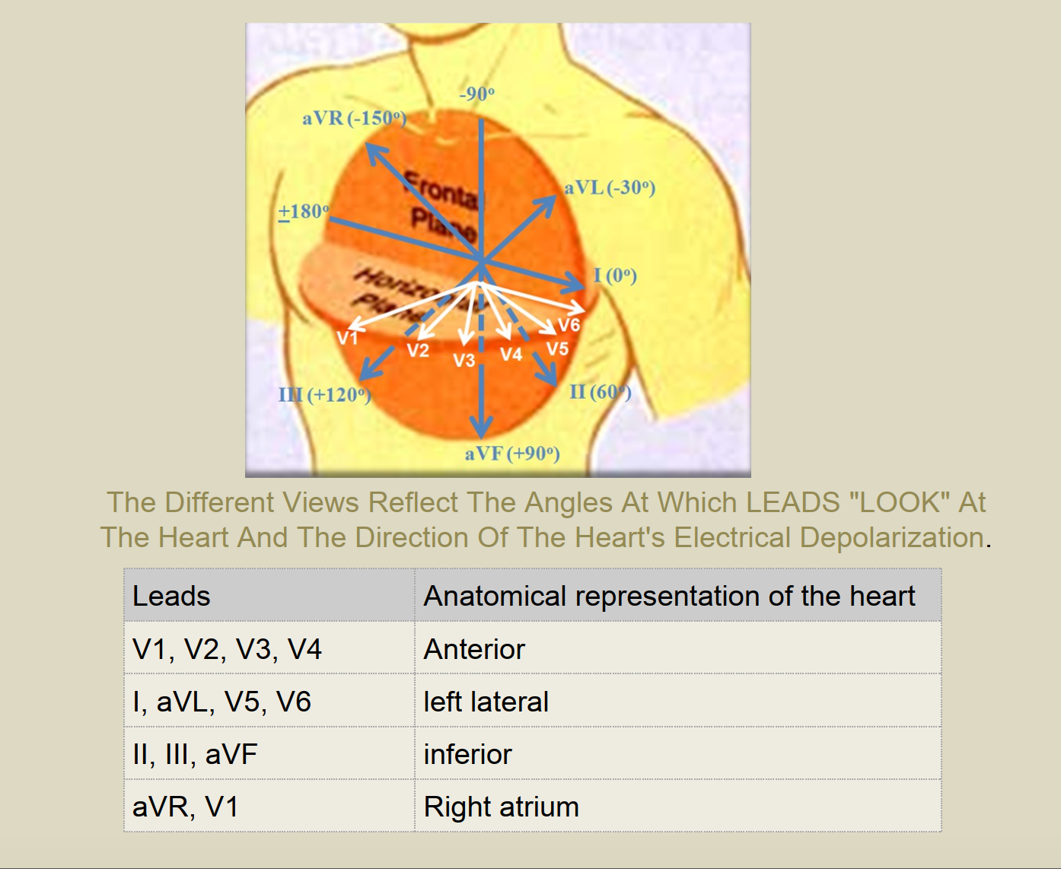
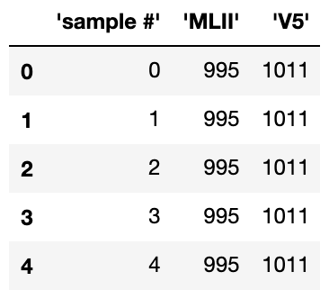
Selected time-series data (ECG/EKG)
Dataset: The MIT-BIH Arrhythmia Database contains 48 half-hour excerpts of two-channel ambulatory ECG recordings. Each recorded data is about 30 minutes long 650,000 samples with the sample rate of 360 per second.
'sample #' column: The sample rate is 360 samples per second per channel with 11-bit resolution over a 10 mV range.
'MLII' column: The upper signal is a modified limb lead II (MLII), obtained by placing the electrodes on the chest.
'V5' column: The lower signal is usually a modified lead V1 (occasionally V2 or V5, and in one instance V4); as for the upper signal, the electrodes are also placed on the chest.

Slide 5
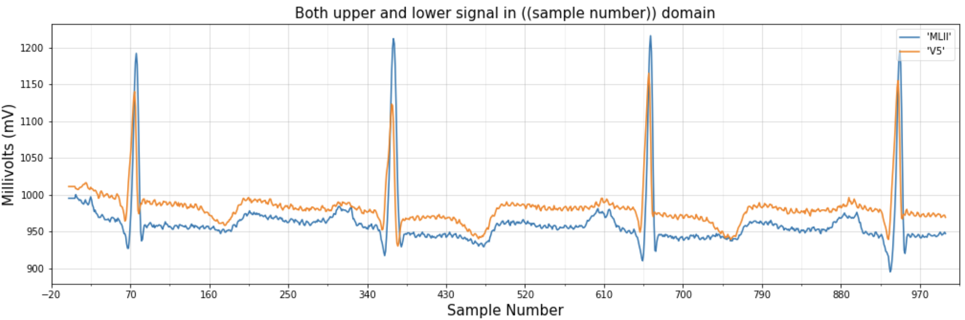
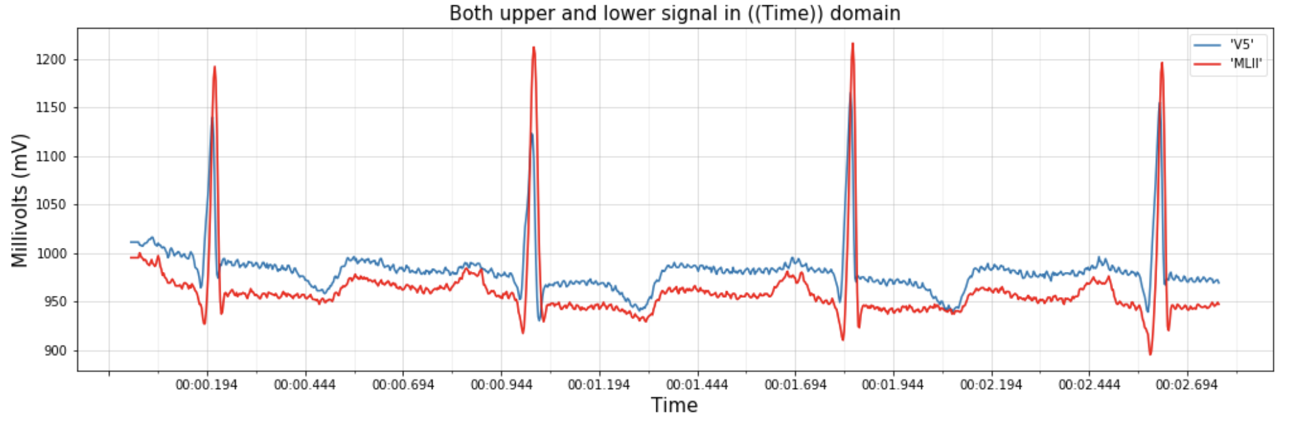
Selected time-series data (ECG/EKG)
Plot of the both upper and and lower signal in time domain.

Slide 6

Signal processing analysis on the data

Slide 7
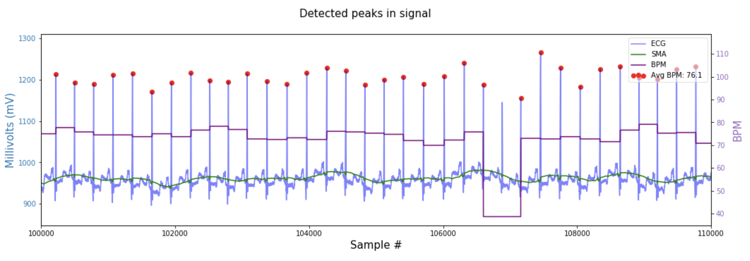
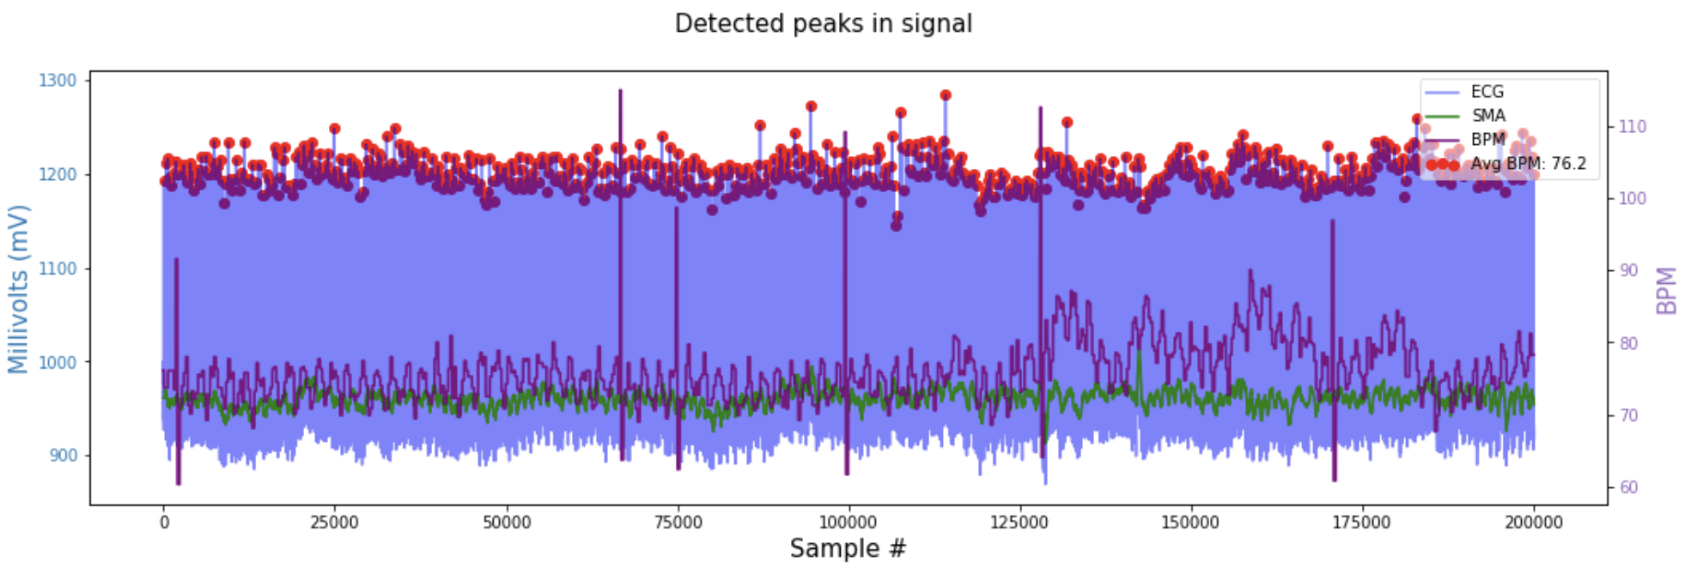
Signal processing analysis on the data
Moving average
Beat Per minutes
R-peak detection

Slide 8
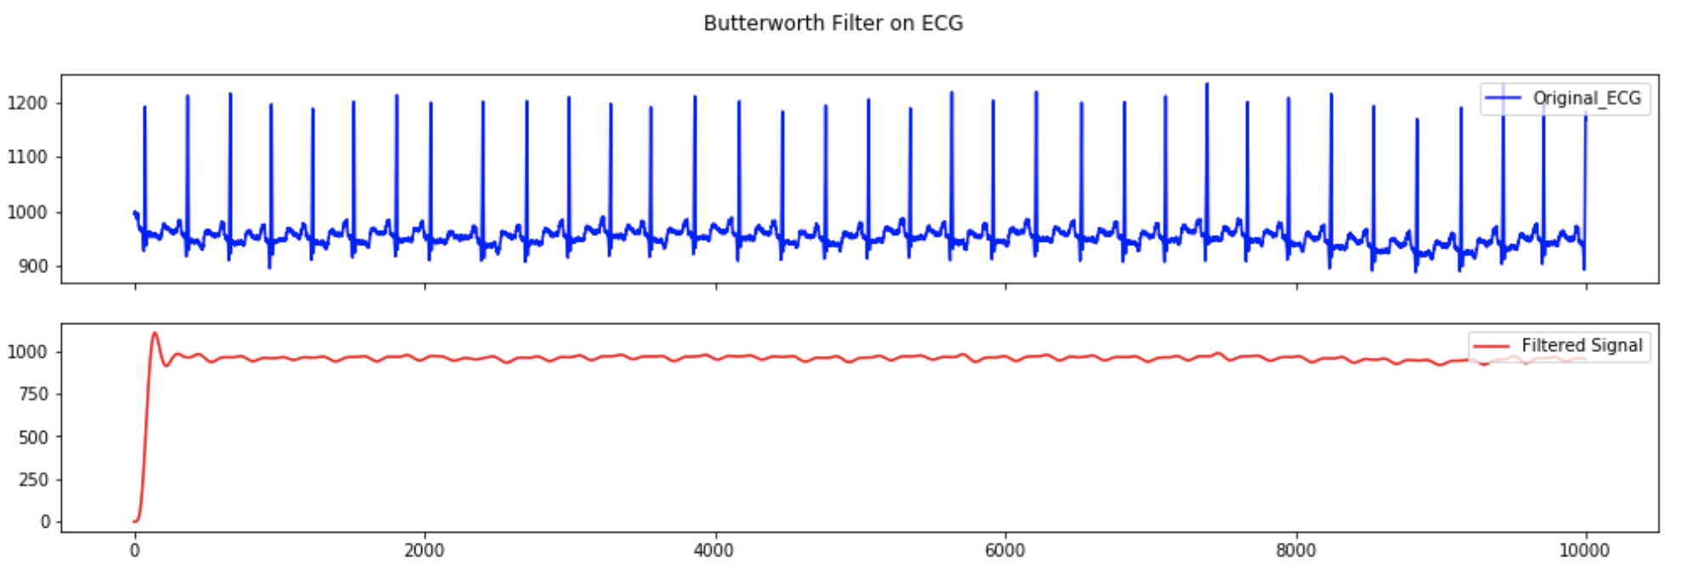
Signal processing analysis on the data
ECG signal noise reduction (Butterworth filter)

Slide 9
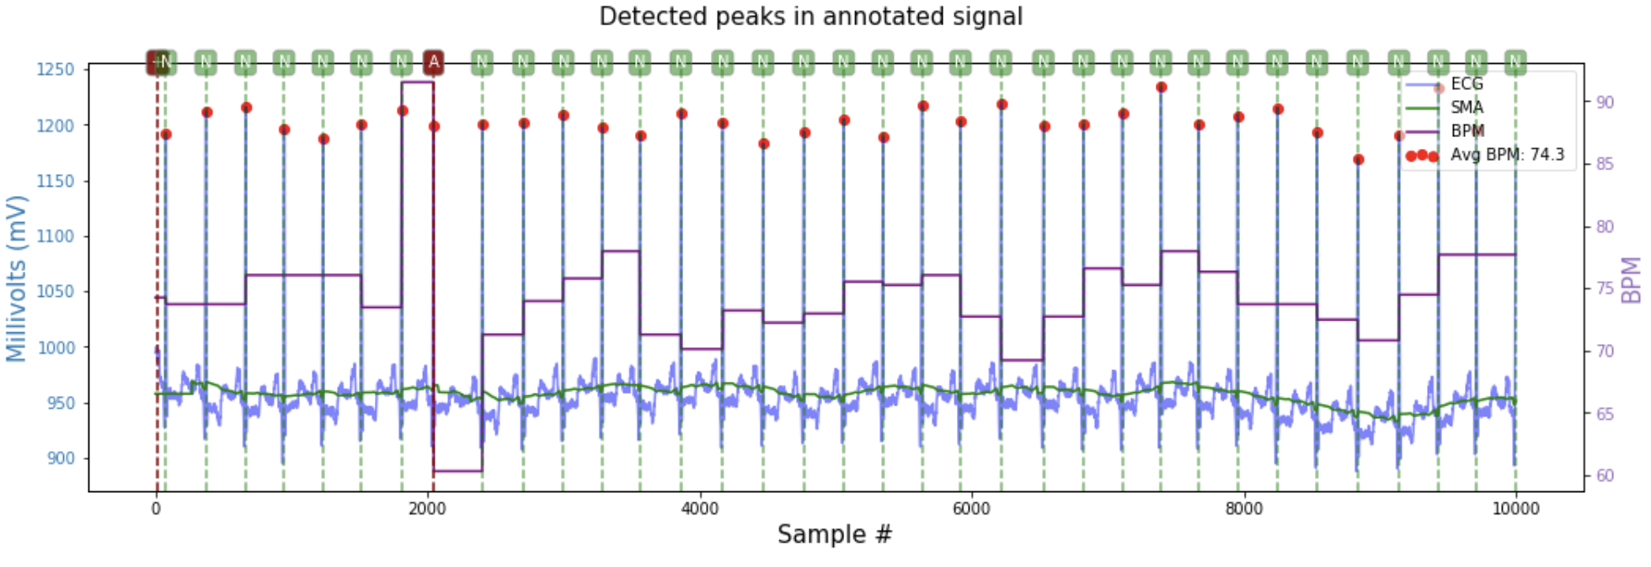
Signal processing analysis on the data
Annotated analyzed signal

Slide 10
Detect heartbeats

Slide 11
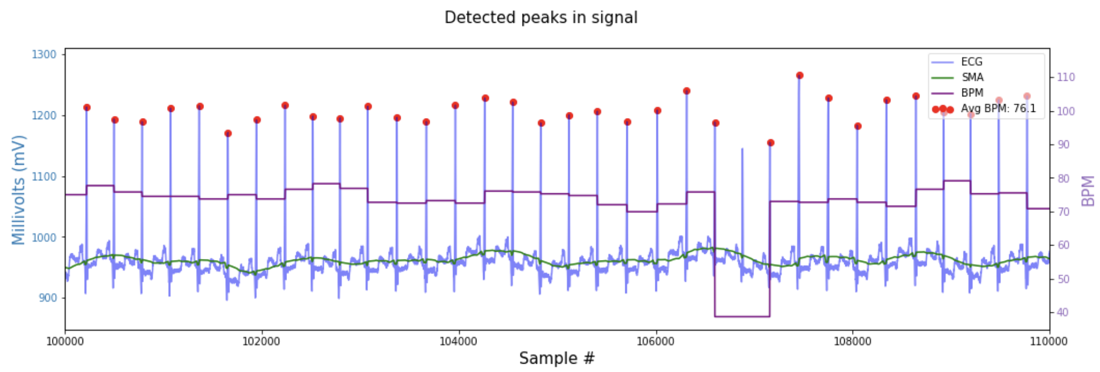
Detect heartbeats
Dynamically shift of moving average for better R-peak detection using RR distance standard deviation

Slide 12
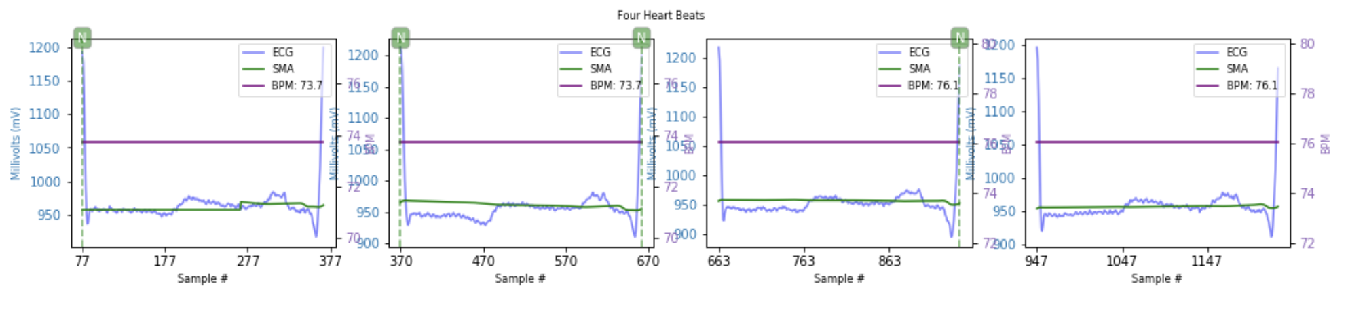
Detect heartbeats
Heartbeat detection using only R-peaks

Slide 13
Build graph for each heartbeat

Slide 14
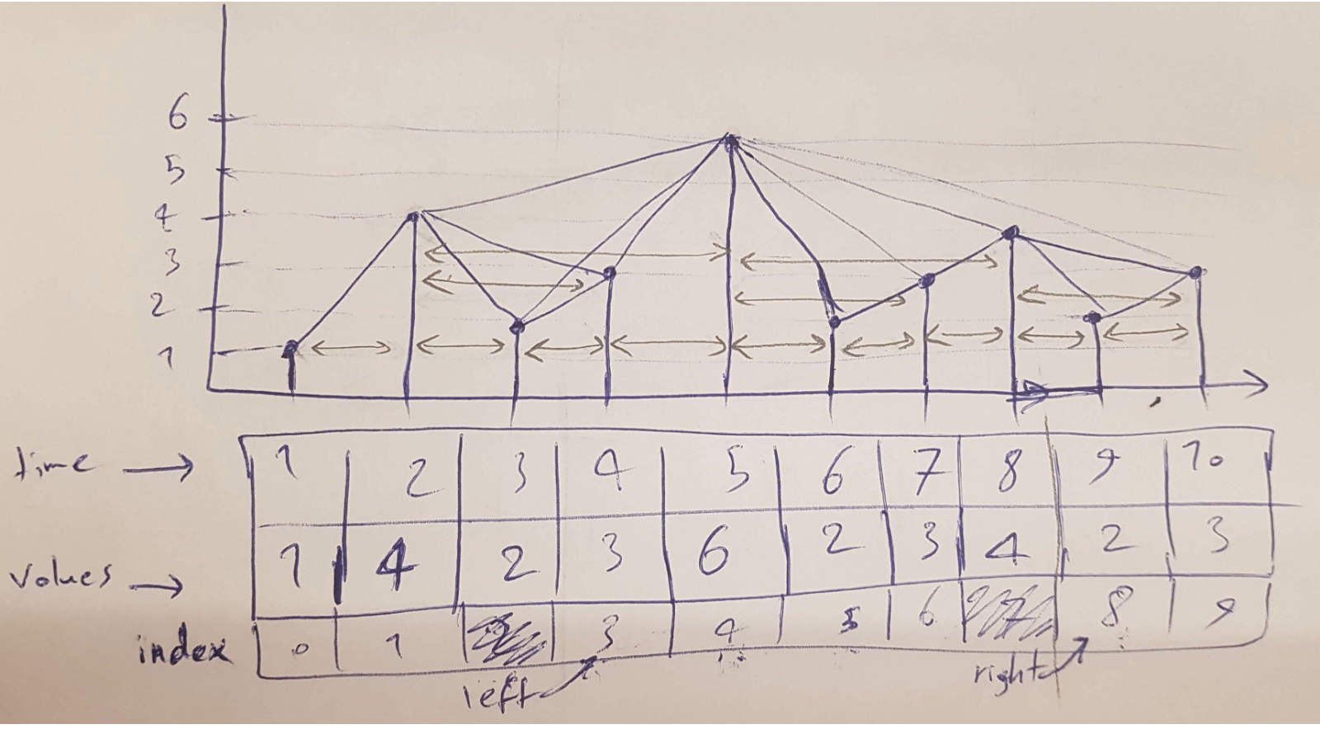
Build graph for each heartbeat
Visibility graph
Horizontal visibility graph
Spectral Visibility Graphs: Application to Similarity of Harmonic Signals (20 Jun 2019)
Efficient On-line Computation of Visibility Graphs (8 May 2019)

Slide 15
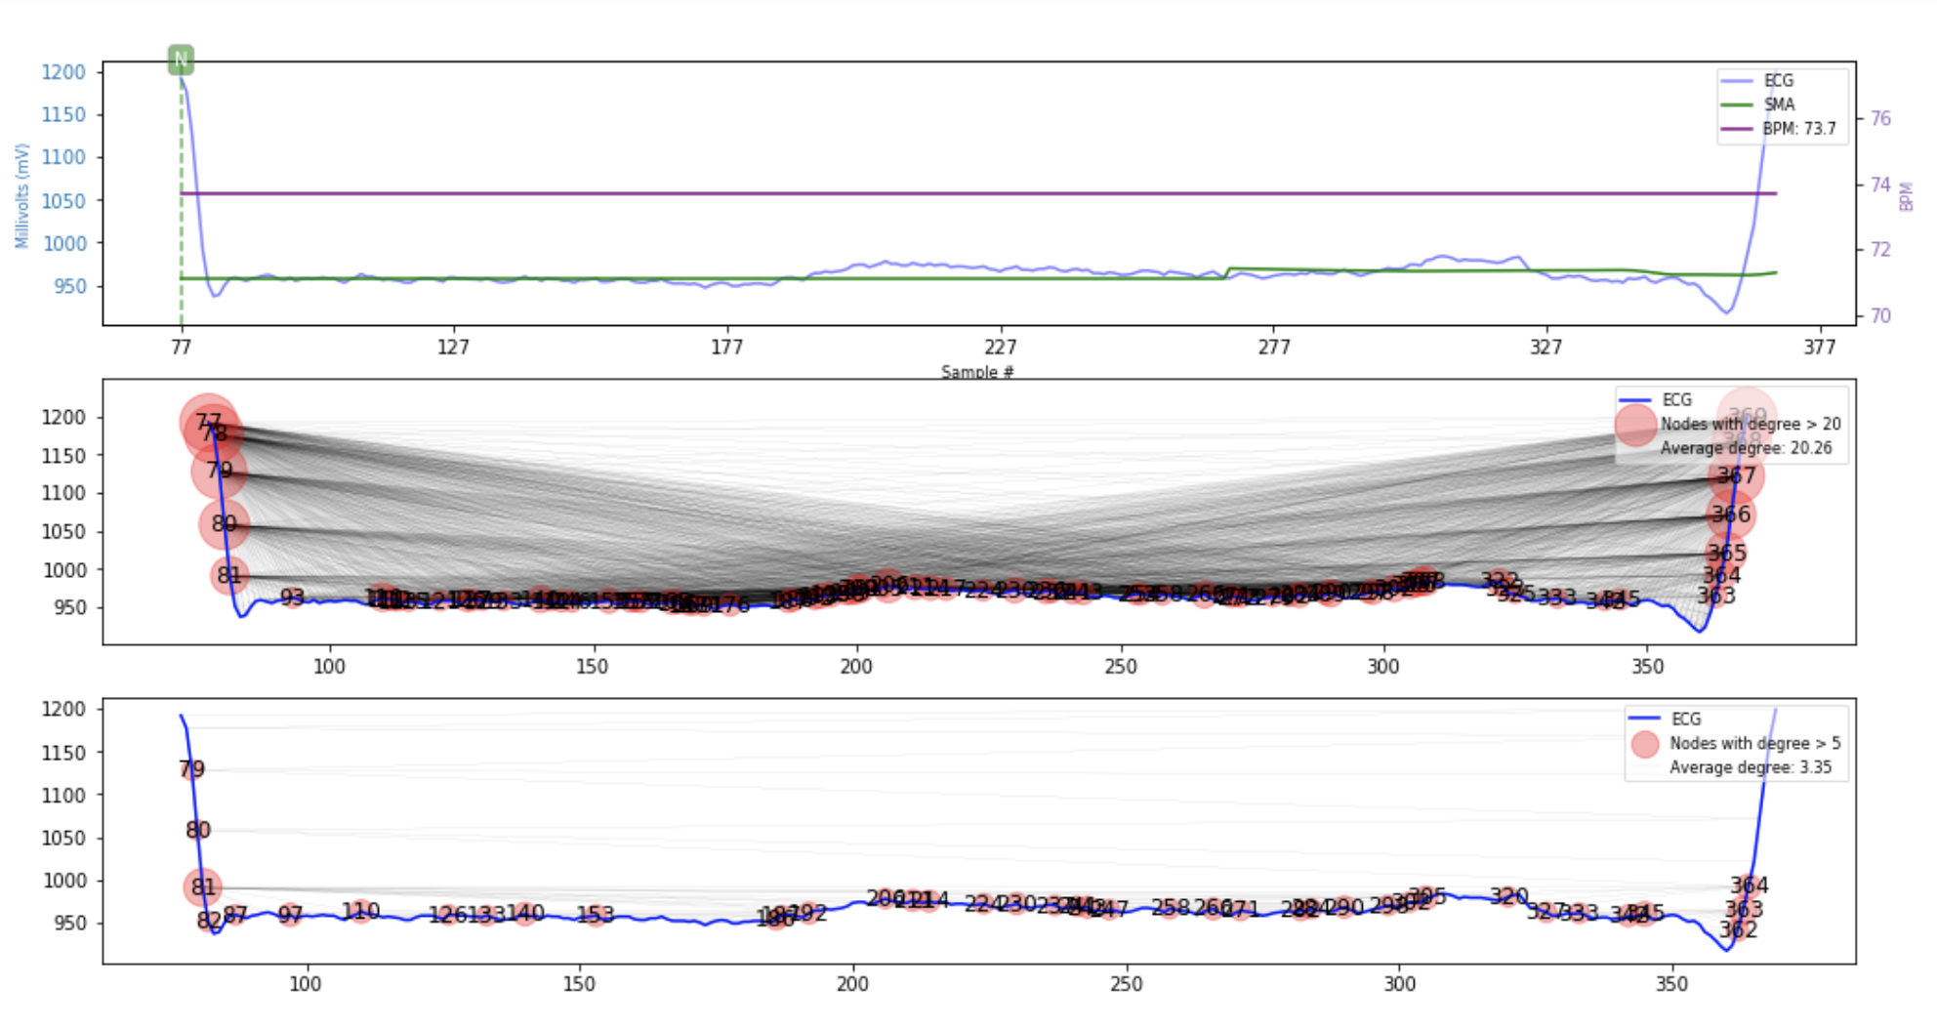
Build graph for each heartbeat

Slide 16
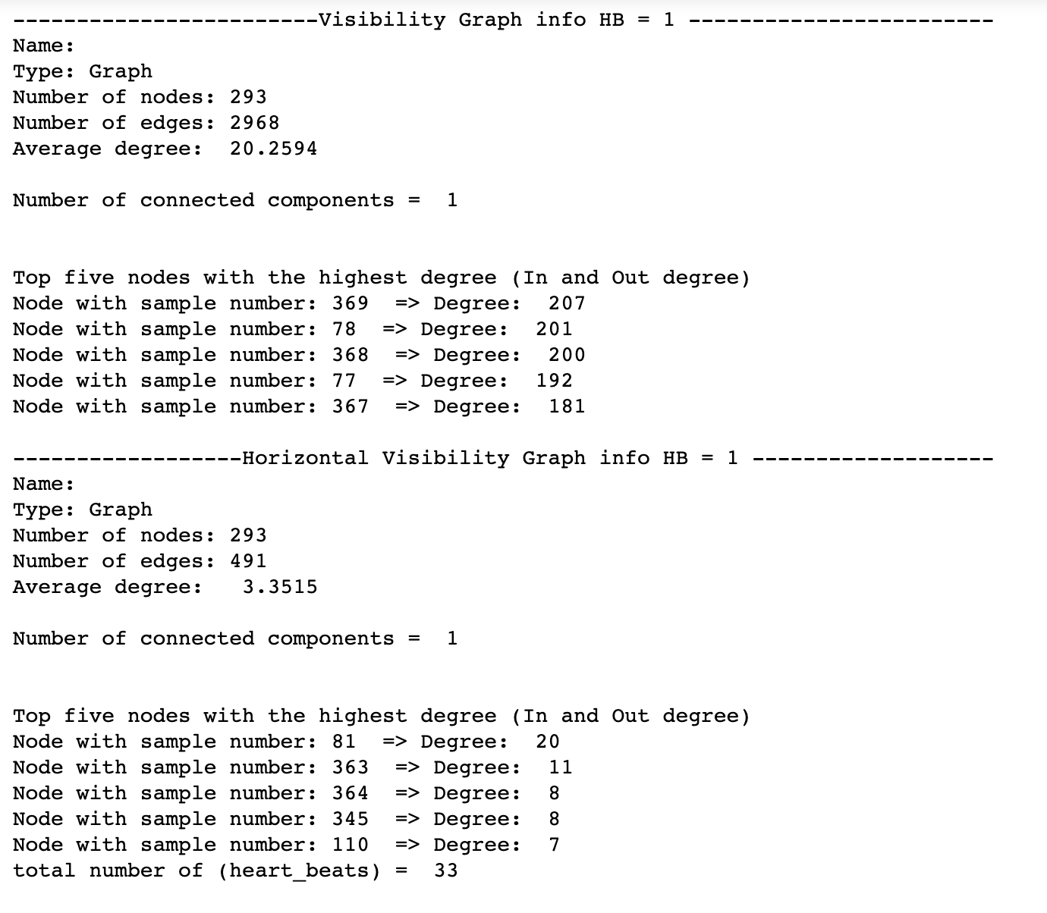
Build graph for each heartbeat

Slide 17
Ideas

Slide 18
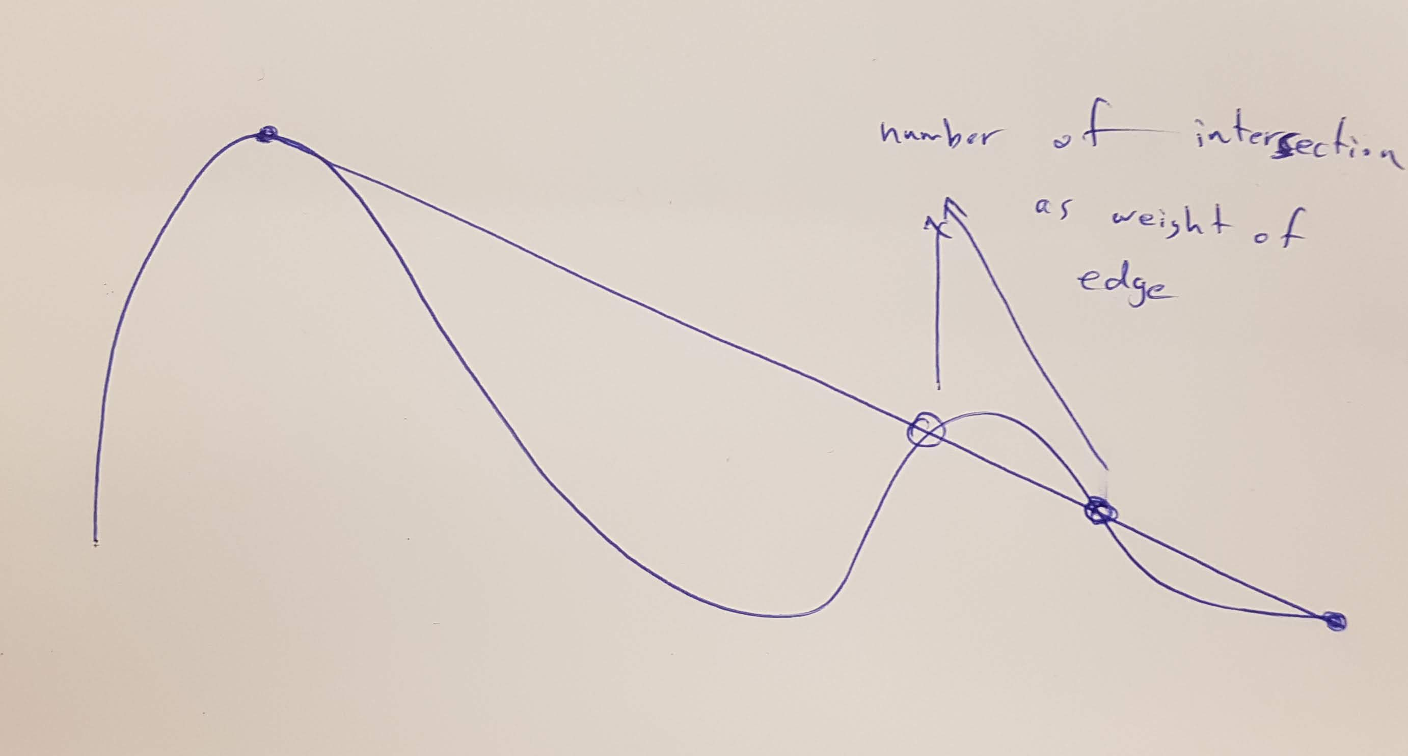
Ideas

